Slide 1

DriverPass System Analysis
Gordon Price
Notes:
[No speaker notes required for this slide.]

Slide 2

System Requirements
Functional Requirements:
User Interface: The System should provide a clean and user-friendly interface to allow easy navigation and interaction, allowing the users to either schedule, modify, or cancel driving lesson reservations seamlessly
Reporting: The System should generate detailed reports on user progress, test results, and driving lesson history, to help accountability and oversight
NonFunctional Requirements:
Performance: The system should have fast responsiveness to user interactions to ensure a seamless and efficient user experience
Security: All user data, including personal or financial information, should be securely stored and only transmitted using encryption and access control measures to protect against any breaches or unauthorized access.
Notes:
[In your speaker notes, include an explanation of the different requirements you determined for DriverPass’s system. What are the functional requirements you selected to describe? What are the nonfunctional requirements you selected to describe? Be sure to explain how these requirements meet DriverPass’s needs.]

Slide 3
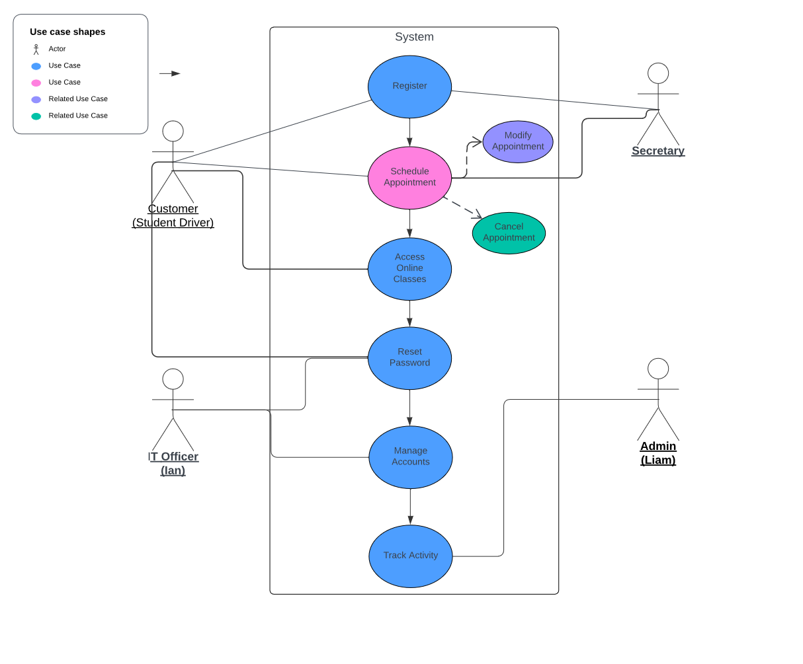
Use Case Diagram
Notes:
In our system, we have different individuals who play specific roles:
Customers, also known as students, are eager individuals looking to enroll in driving lessons to master the art of driving.
Secretaries, responsible for managing appointments, ensuring smooth scheduling to accommodate learners' convenience.
IT Officers, like Ian, serve our digital guardians, safeguarding the system's integrity through meticulous maintenance and user account oversight.
Administrators, such as Liam, act as the architects of the system, meticulously sculpting its landscape and configurations with a focus on efficiency and innovation.
Now, let's talk about the different functionalities or tasks these individuals can perform within the system:
Register: Students can sign up for driving lessons.
Schedule Appointment: Customers can book their driving lessons.
Modify Appointment: Users have the flexibility to adjust their scheduled appointments.
Cancel Appointment: Customers can cancel their upcoming driving lessons if needed.
Access Online Classes: Provides access to online driving classes and practice tests for enhanced learning.
Reset Password: Allows users to reset their passwords if forgotten.
Manage Accounts: IT officers can manage user accounts, ensuring smooth operations and security.
Track Activity: Facilitates monitoring and tracking of user interactions and activities within the system.

Slide 4
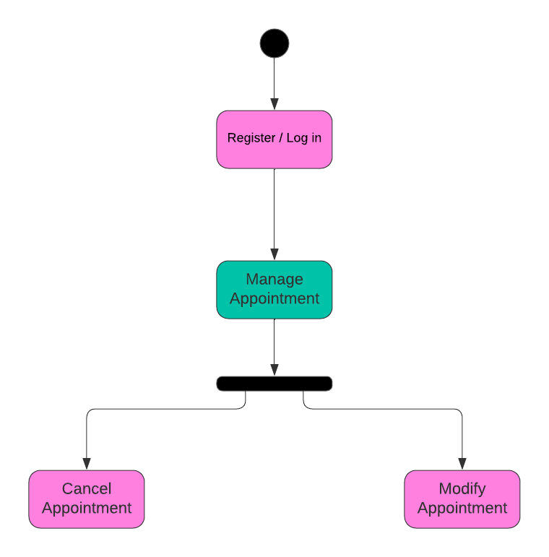
Activity Diagram
Notes:
Start
Register / Login: Users begin by either registering for a new account or logging into an existing one. This step ensures that only authenticated users can proceed further.
Manage Appointment: After logging in, users are directed to the "Manage Appointment" activity, where they can perform various actions related to their appointments.
Decision Tree: This is a decision point in the process where users must choose between two options: canceling or modifying their appointment.
Cancel Appointment (Tree 1): If users choose to cancel their appointment, they follow the path represented by Tree 1. This path likely involves confirming the cancellation and receiving a confirmation message.
Modify Appointment (Tree 2): If users choose to modify their appointment, they follow the path represented by Tree 2. This path likely involves selecting the appointment to modify, making changes to the appointment details (such as date or time), and confirming the modifications.

Slide 5
Security
Secured Storage: User data is encrypted for protection against unauthorized access.
Protected Transmission: Data transmitted between users and the system is encrypted to prevent interception.
Access Control: Different user roles have distinct access privileges, ensuring authorized actions only.
Authentication Mechanism: Secure login credentials are required for accessing accounts and performing actions.
Audit Trail: User activities are logged to provide accountability and traceability.
Regular Maintenance: IT officer ensures security measures are up-to-date through regular maintenance.
Compliance with Regulations: System design complies with relevant regulations for data protection.
User Education: Users receive guidance on security best practices to enhance overall system security.
Notes:
[How did you consider security in your design? In your explanation, keep your audience in mind by avoiding the use of technical terms.]

Slide 6
System Limitations
Limited Feature Expansion: The system can't easily add or remove features without technical help.
Separate Feature Releases: New features will be added later, not all at once.
Learning Curve: Users might need time to get used to how the system works.
Internet Required: You need internet to use the system.
Basic Features: The system might not have everything you want at first.
Notes:
[What are the limitations of your design? In your explanation, keep your audience in mind by avoiding the use of technical terms.]

